Slide 1
MADE BY TEAM 4: SIDDHARTHA PATRA (0787887) USAMA NORAT (0792225) AMIR DAHYA (0791252)
DAB 401
AMERICAN EXPRESS
FINANCIAL ANALYSIS

Slide 2

AMERICAN EXPRESS
American Express (AXP), also known as Amex, is a global financial services company headquartered in New York City.
It is known for its charge cards, credit cards, and traveler's cheques. Founded in 1850, American Express has become one of the world's largest issuers of credit cards, and it operates in over 130 countries.
The company is committed to providing exceptional customer service, and it has a reputation for offering premium rewards and benefits to its cardholders.

Slide 3
COMPANY VALUATION
CAPITAL ASSET PRICING MODEL
DIVIDEND GROWTH MODEL
AXP Beta (5Y Monthly) | 1.2
(As Indicated @ Yahoo Finance as of 2023-03-30)
Risk-Free Rate | 3.67%
(US 5 Year Treasury Rate as of 2023-03-30)
Expected market return (Yearly) | 8.90%
AXP Expected Rate of Return | 9.9515%
Average 5 Year Dividend Growth % | 8.58%
AXP Expected Rate of Return | 9.95%
Estimated Stock Value (using the constant growth model) | $157.23
Actual Stock Value (as of 2023-03-30) | $162.41

Slide 4
FINANCIAL RATIOS
LIQUIDITY RATIOS
PROFITABILTY RATIOS
Current Ratio Current Assets / Current Liabilities | 1.58
Quick Ratio (Current Assets - Inventory) / Current Liabilities | 1.58
Cash Ratio Cash & Cash Equivalents / Current Liabilities | 0.27
Gross Profit Margin Gross Profit / Net Sales * 100 | 104.31%
Operating Profit Margin Operating Earnings / Total Revenue * 100 | 23.36%
Return on Assets (ROA) Net Income / Assets * 100 | 3.29%
Return on Equity (ROE) Net Income / Shareholder’s Equity * 100 | 30.41%
Return on sales Operating Profit / Net sales | 24.36%

Slide 5
FINANCIAL RATIOS
TURNOVER RATIOS
SOLVENCY RATIOS
Inventory Turnover Ratio Costs of Goods Sold / Average Inventory | NA
Accounts Receivable Turnover Ratio Net Credit Sales / Average Accounts Receivables | 0.77
Accounts Payable Turnover Ratio Net Credit Purchases / Average Accounts Payable | NA
Solvency Ratio (Net Income + Depreciation) / All Liabilities (Short-term + Long-term Liabilities) | 1.72
Debt-to-equity ratio Total Debt / Shareholders' Equity | 0.04
Sustainable Growth Rate Steady rate at which a firm can grow: plowback ratio * return on equity | 24.27%
EARNING RATIOS
Price-to-earnings ratio (P/E ratio) Market value per share / Earnings per share (EPS) | 16.11
Dividend Payout Ratio Dividends per share / Earnings per share | 20.18%

Slide 6
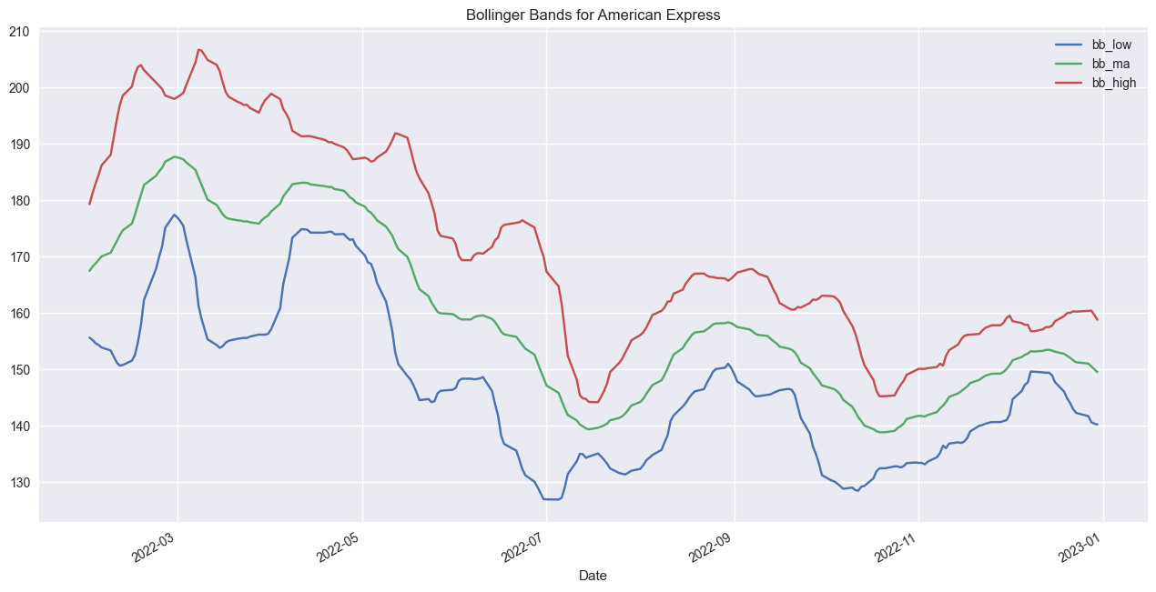
TECHNICAL ANALYSIS & MONTE CARLO SIMULATION
BASED ON 10,000 MONTE CARLO SIMULATION:
AMERICAN EXPRESS STOCK PRICE & BOLLINGER BANDS (Time Period: January 1, 2022 - December 31, 2022)
Average Price | 165.4453
Std. Dev | 3.706737
Avg. Return | 12.36%
Std. Dev. Return | 0.025175
Positive | 100.00%
5% Return | 99.82%
10% Return | 82.98%

Slide 7
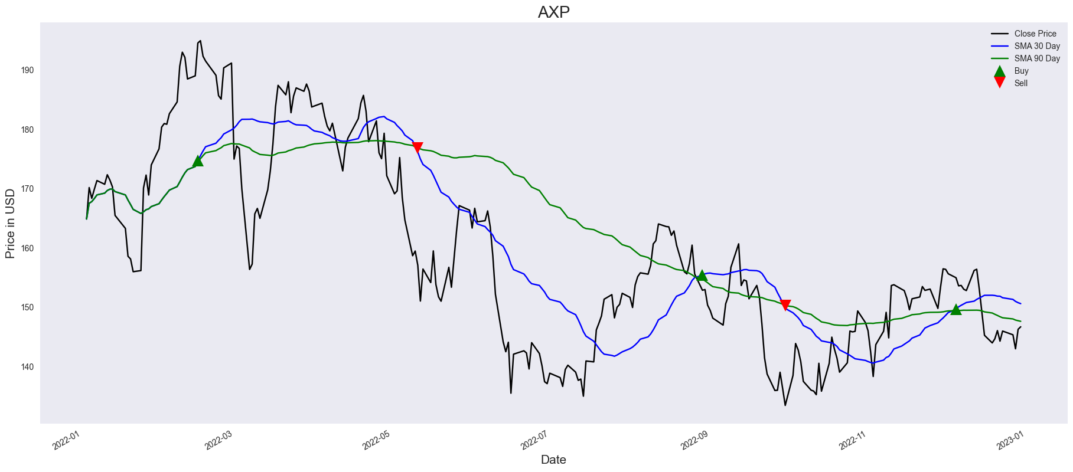
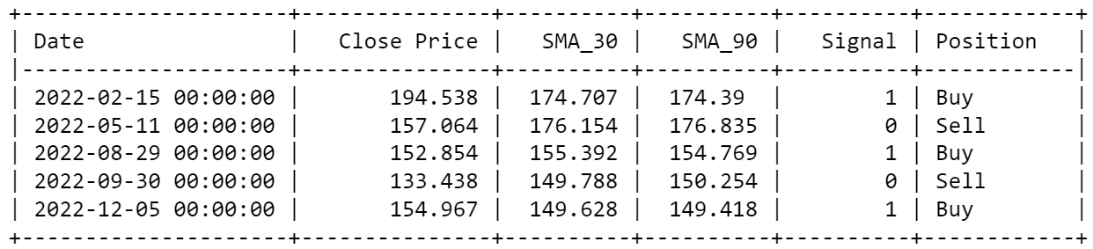
STOCK SIGNALS
USING SIMPLE MOVING AVERAGE

Slide 8
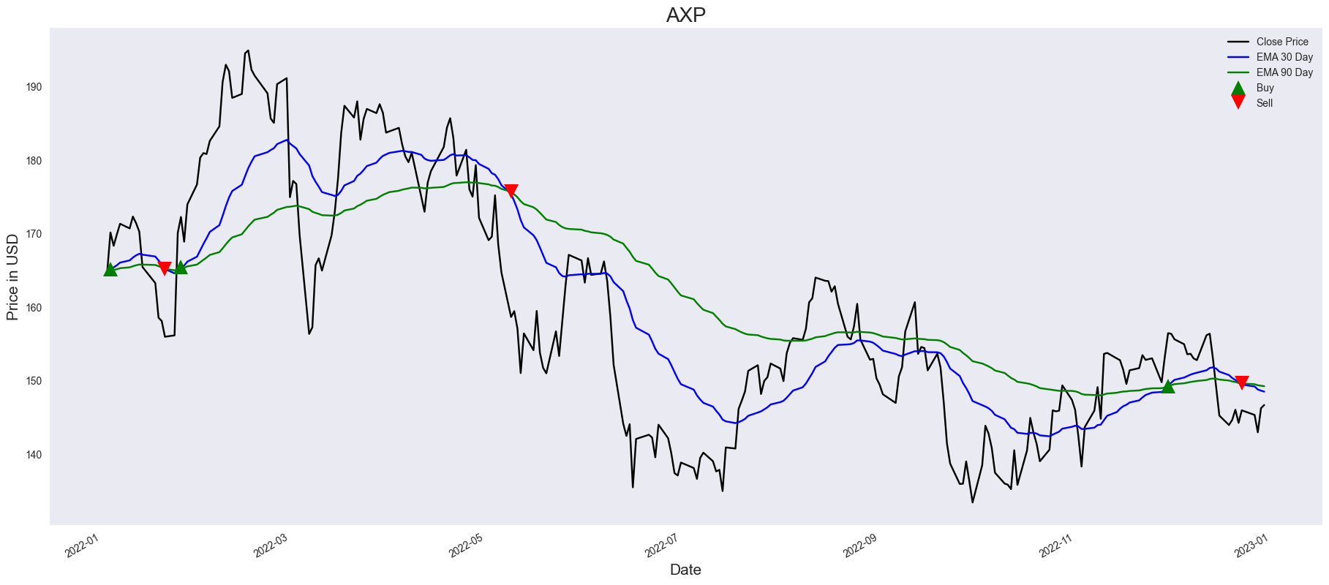
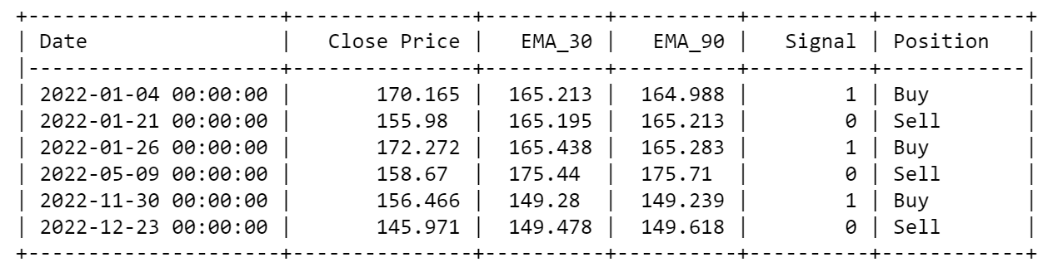
STOCK SIGNALS
USING EXPONENTIAL MOVING AVERAGE

Slide 9
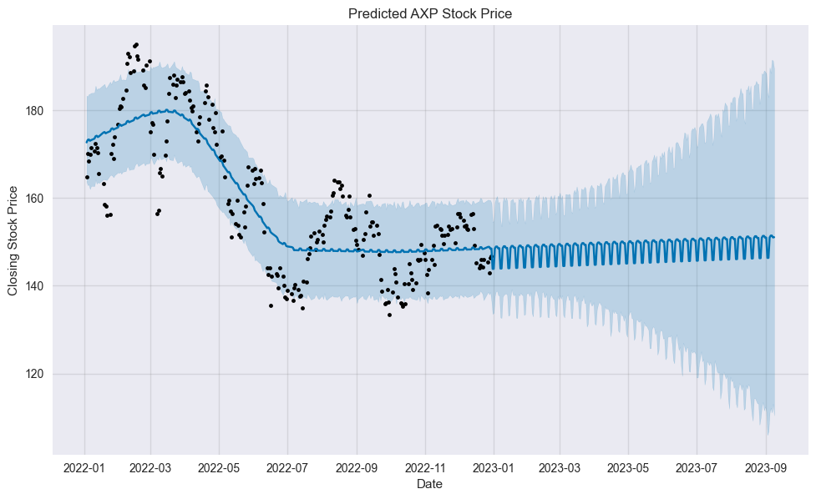
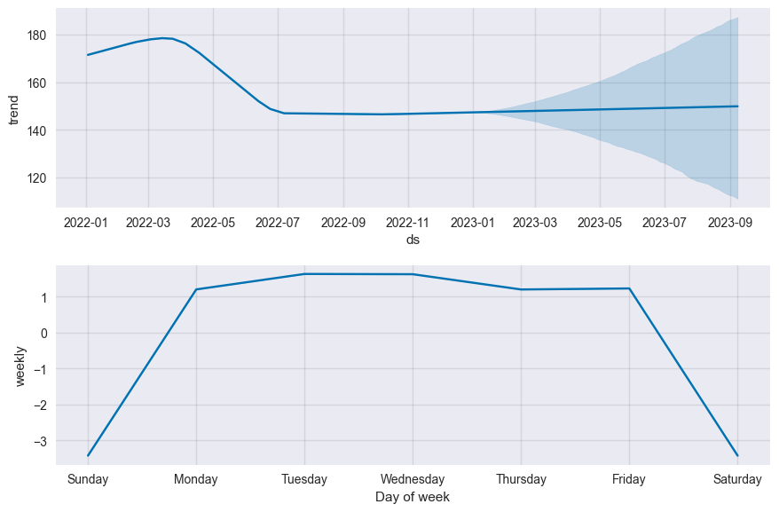
STOCK FORECASTING
AMERICAN EXPRESS STOCK PRICE FORECAST
YEARLY AND WEEKLY TRENDS

Slide 10
OUR RECOMMENDATION
CRITERIA | DECISION (BUY, SELL or HOLD) | REASON
Based on Company Valuation | SELL | Based on the Capital Asset Pricing Model, the expected rate of return for AXP is 9.9515%, which is higher than the risk-free rate and the expected market return. As per Dividend Growth Model the estimated stock value for AMEX is $41.08, however the actual stock value is significantly higher than this estimate, it may indicate that the stock is overvalued. Hence, we should consider selling.
Based on Financial Ratios | HOLD | Based on the high liquidity ratios, AMEX has enough liquid assets to cover its short-term obligations. However, Solvency Ratio is relatively low indicate that AMEX has a high level of debt or is not generating enough income to cover its long-term obligations. Debt-to-Equity ratio is also relatively high, which indicates that the company is highly leveraged and may be more vulnerable to economic downturns. Hence, we should hold until further research & analysis is done.

Slide 11
OUR RECOMMENDATION
CRITERIA | DECISION (BUY, SELL or HOLD) | REASON
Based on Technical Analysis & Monte Carlo Simulation | BUY | The simulations show that 100% of the outcomes had a positive return, and 99.82% of the outcomes had a return of 5% or more. Additionally, 82.98% of the outcomes had a return of 10% or more.. Overall, these results suggest that the stock may be a good investment opportunity, as it has a high probability of generating positive returns and a relatively high average return.
Based on Stock Signals | SELL (for short term) HOLD (for long term) | Based on the provided stock signals, it appears that the stock has been experiencing some volatility and changes in trend. The SMA and EMA signals suggest that the stock may be experiencing some short-term upward momentum, Hence, selling short-term could be beneficial. However, for the long-term it may be wise to hold as the overall trend is negative for the year.

Slide 12
OUR RECOMMENDATION
CRITERIA | DECISION (BUY, SELL or HOLD) | REASON
Based on Stock Forecasting | HOLD | Forecast shows neither an increasing nor a decreasing trend. Hence holding the stock is advised and keep an eye on any future developments that may impact the company's performance.
OVERALL RECOMMENDATION | HOLD | Based on all the criteria discussed before

Slide 13
THANK YOU!

